Slide 1


Space Exploration
WORLD HISTORY READERS
Level 3-①

Slide 2
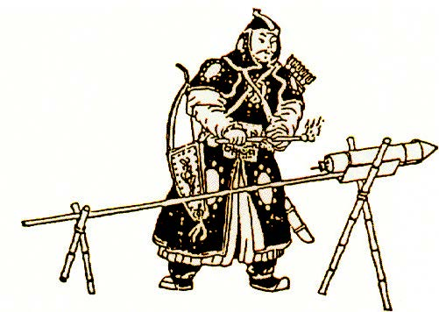
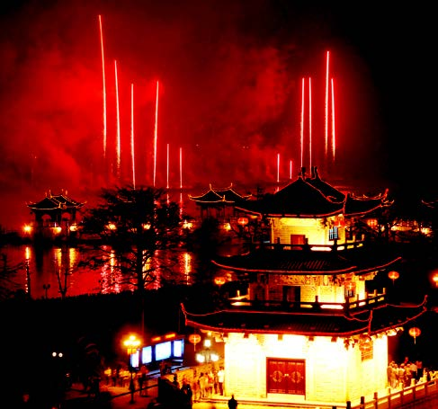
The First Rockets
An ancient Chinese rocket
When were the first rockets made?
The Chinese made the first rockets hundreds of years ago. They used them for making war and for ceremonies.
Did these rockets go into orbit?
No, the rockets were not powerful enough. Technology wasn't good enough back then.
Chinese fireworks at New Year

Slide 3
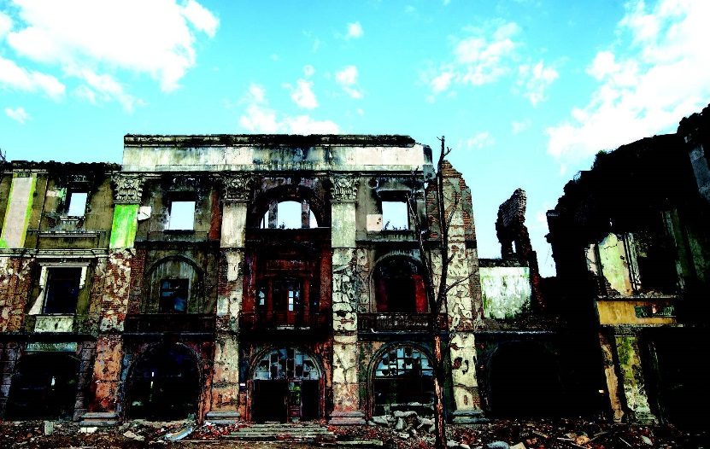
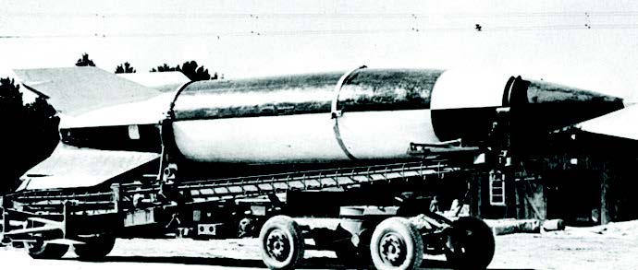
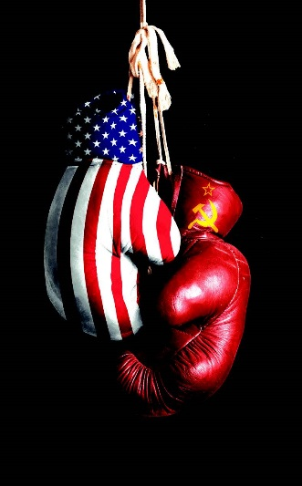
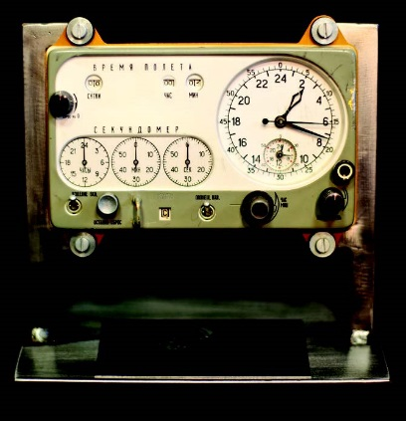
The Early 20th Century
Ruins of a building after it was bombed
How did rockets change in the early 20th century?
During the 1930s and 1940s, the Germans used
long-range rockets in WWII. Some of their rockets could fly 320 km and 95 km into the air at 5,600 km per hour. Scientists in the US and the USSR believed these designs could be used for space travel.
The German V2 rocket
A symbol of the US and USSR during the Cold War
A Soviet space clock
In the 1950s and 1960s, the US and the USSR wanted to be first into space so they could show off their technologies and power.

Slide 4
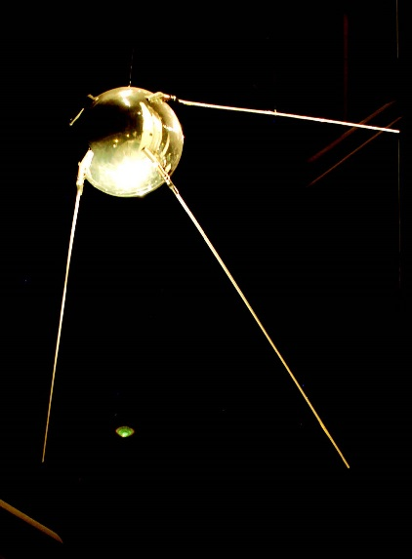
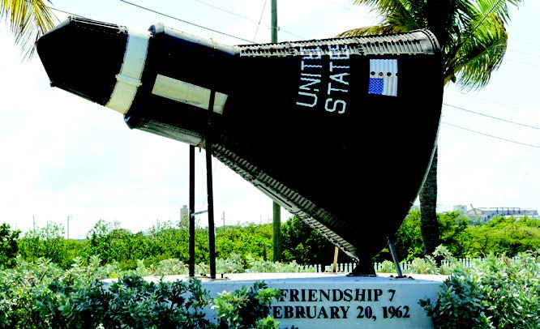
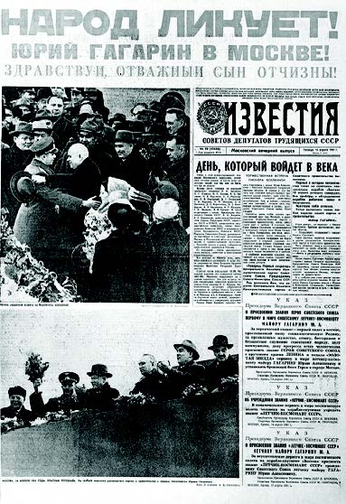
The Space Race
What was the first satellite to go into space?
A replica of John Glenn’s spacecraft, 1962
Sputnik 1 was the first satellite to go into space in 1957. It was owned by the Soviet Union.
Sputnik 1
Who was the first man in space?
When did the first American go into space?
The Russian Yuri Gagarin was the first man to go into space in 1961. His flight was only 108 minutes long, but he went 327 km from Earth.
The first American went into space in 1962. His name was John Glenn.
A news report of Yuri Gagarin’s flight

Slide 5
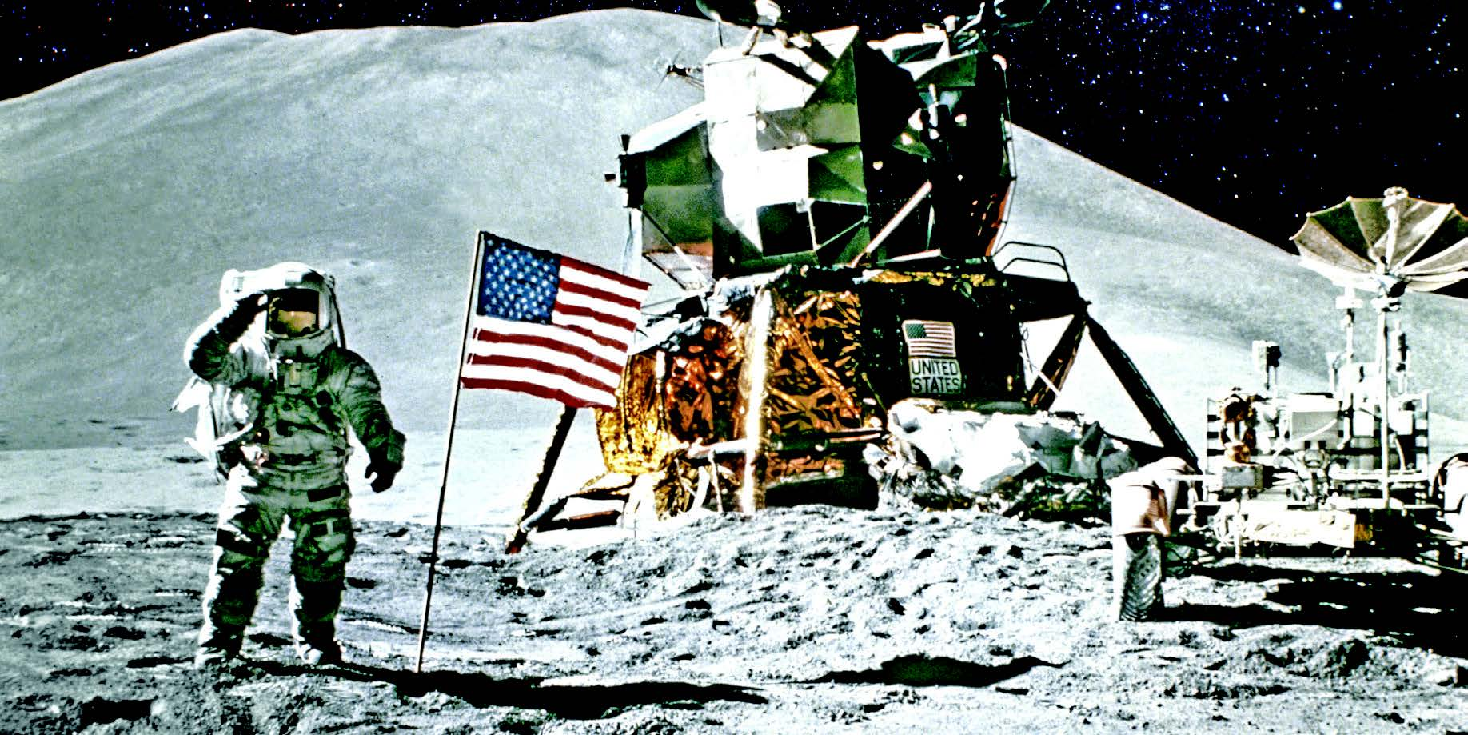
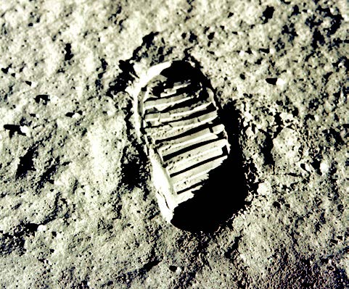
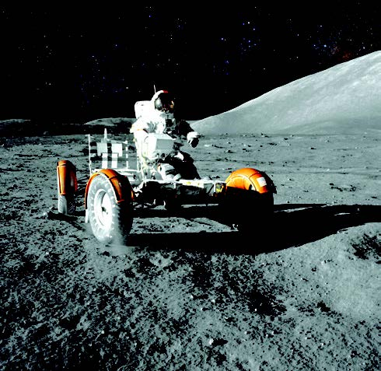
Fly Me to the Moon
When did the first man walk on the moon?
On July 20, 1969, Neil Armstrong set foot on the moon.
A footprint on the moon
Landing on the moon
The Lunar Rover
Do astronauts regularly go to the moon now?
What did he say when he stepped onto the moon?
No, before 1972, there were five more missions to the moon, but we haven’t been back since.
“That’s one small step for man, one giant leap for mankind.”

Slide 6
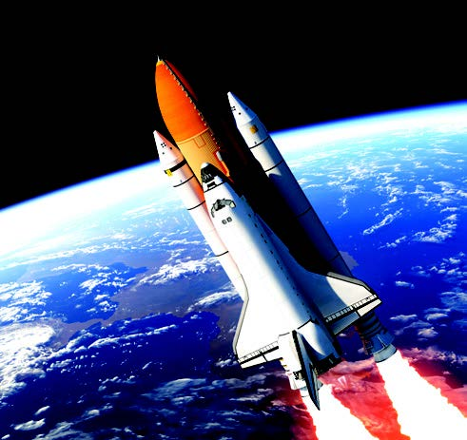
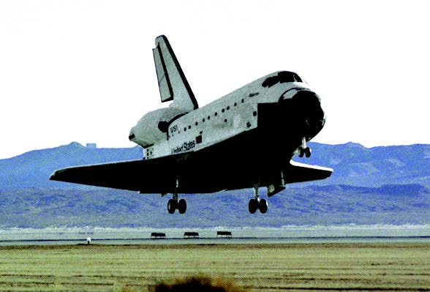
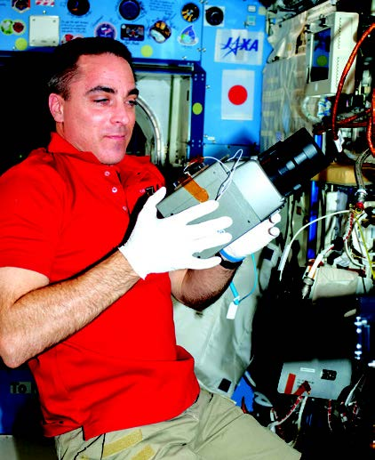
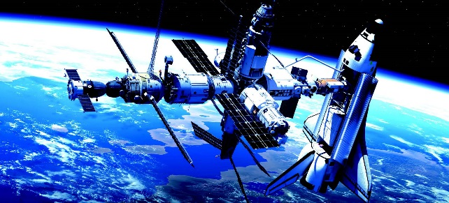
The International Space Station (ISS)
How did space exploration change in the 1980s?
In 1981, the Americans began the Space Shuttle era. The shuttles could carry things into orbit and land back on Earth. The fleet flew 135 missions to space from 1981 to 2011.
How were the space shuttles related to the International Space Station?
One of the space shuttles
Space Shuttle Atlantis landing
The space shuttles carried pieces of the International Space Station (ISS) into space.
What is the ISS?
The ISS is a research laboratory manned by up to six people at one time. Sixteen countries are involved in the ISS project. It is the size of an American football field and has been conducting research in space since November, 2000.

Slide 7
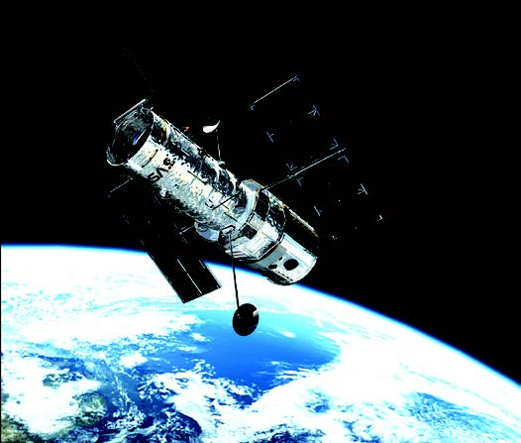
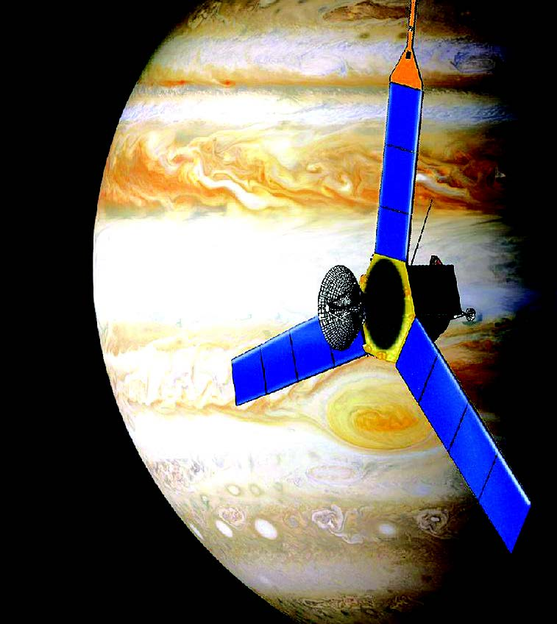
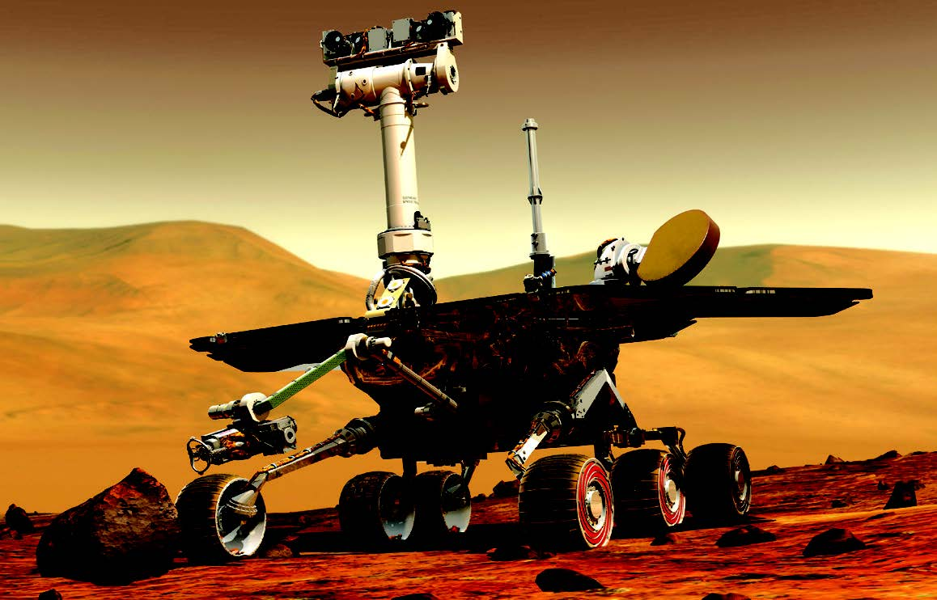
Space Explorers
The Hubble Space Telescope in orbit
The Juno space
probe near Jupiter
One of the remote landing vehicles
What was launched in 1990 and continues to discover amazing things about our universe?
What other things have been used to explore space?
In the past 50 years, scientists have used satellites, space probes, space telescopes, and remote landing vehicles such as the Mars rovers to explore our solar system and beyond.
The Hubble Space Telescope

Slide 8
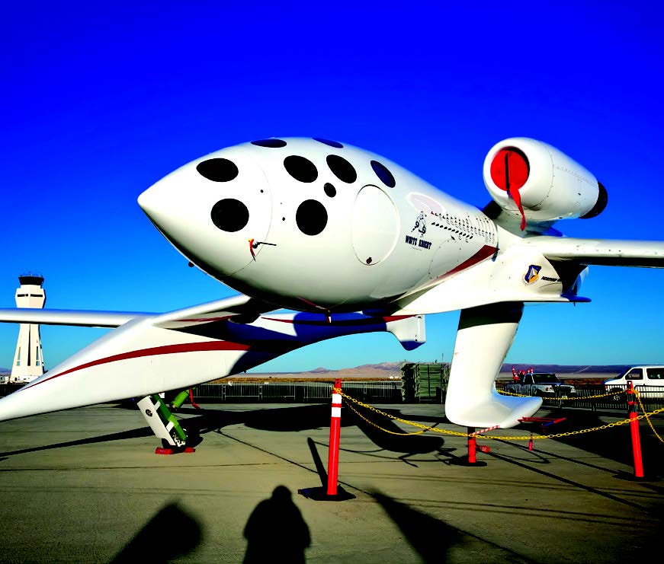
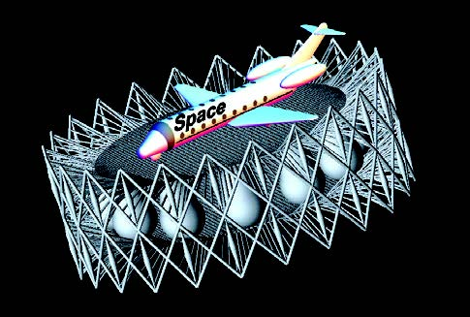
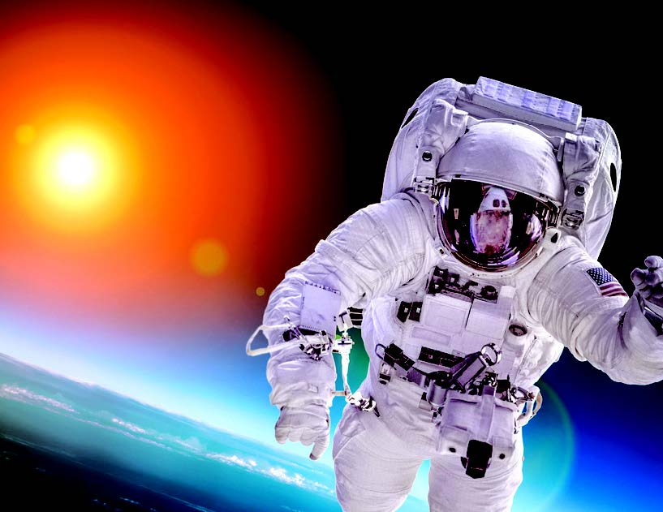
Private Space Travel
An idea for a space hotel
Are governments the only ones trying to explore space?
SpaceShipOne, a reusable, low-orbit spacecraft
No, governments are not the only ones trying to get to space. Hundreds of private companies now build reusable rockets, satellites, and other technologies to offer trips into space. There are plans for day trips into space, and even hotels!
An astronaut in space

Slide 9
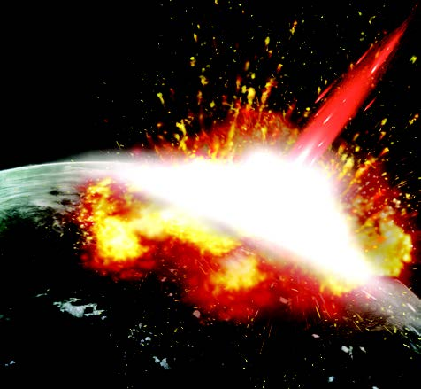
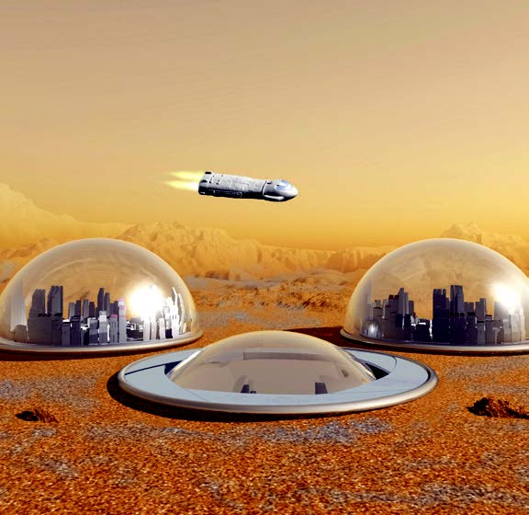
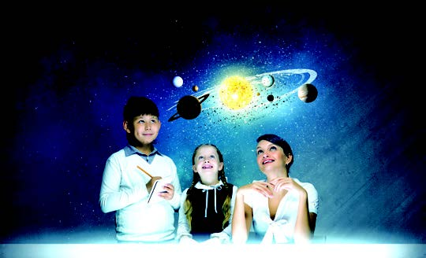
Beyond Planet Earth
Why do people still want to explore space?
First, the Earth is becoming full. We are using too many of our resources. Everyone on Earth may die some day. And second, anything could happen—an illness could wipe everyone out or a huge asteroid could hit our planet.
Are there other benefits to space exploration?
Yes, there are. Much of our modern-day technology comes from research done to help the space programs. Going into space has also helped us find out more about where we came from and why we are here.
An asteroid hitting Earth
Our future on Mars?

Slide 10
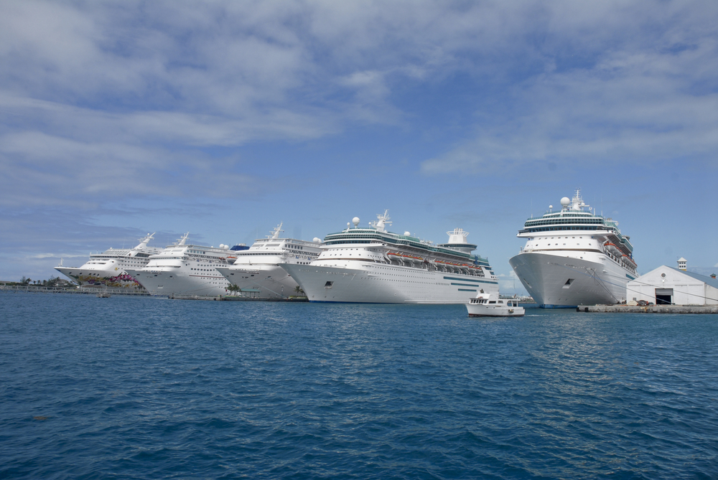
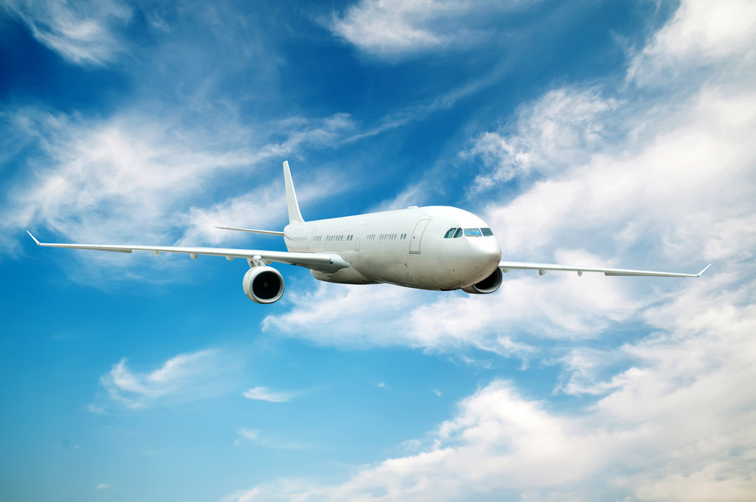
Vocabulary
fleet n.
a group of ships or spacecraft
flight n.
the act of flying

Slide 11


Vocabulary
illness n.
a disease or sickness of the body or mind
prize n.
a reward for victory or superiority, as in a contest or competition

Slide 12

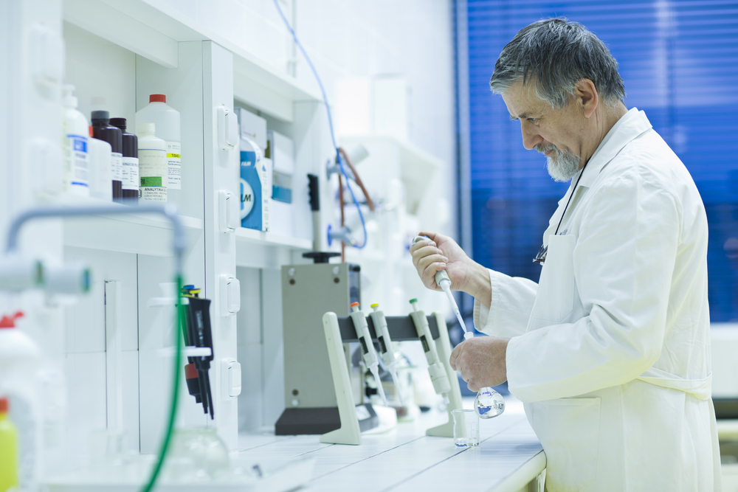
Vocabulary
reusable adj.
able to be used again or more than once
research laboratory n.
a place to do scientific study

Slide 13
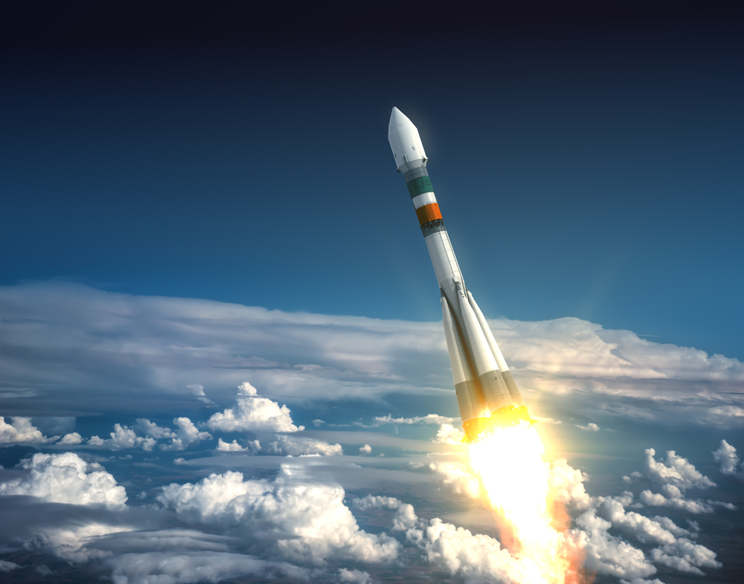
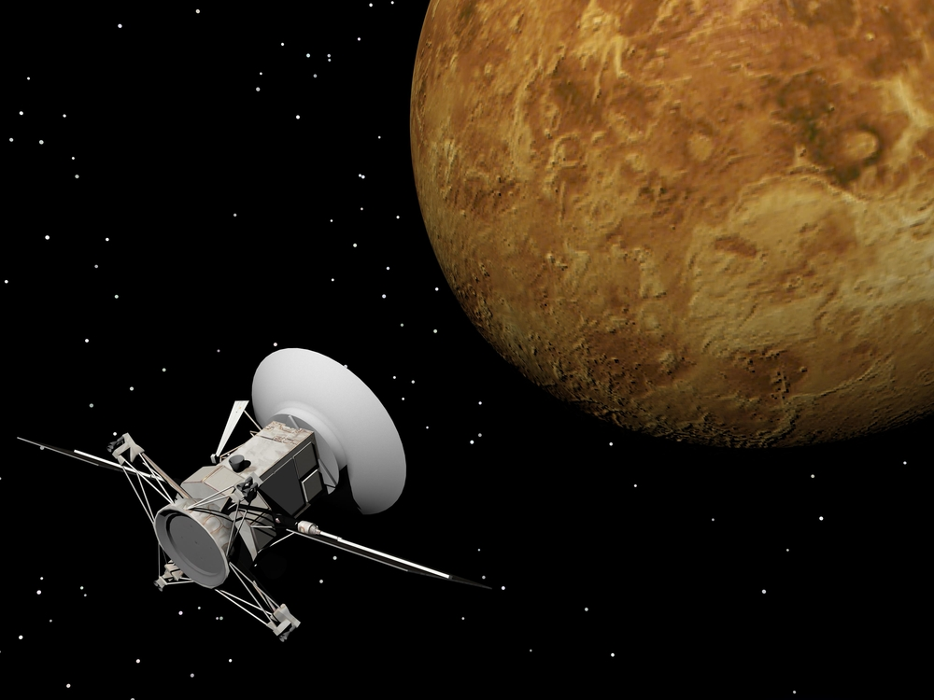
Vocabulary
rocket n.
an object that goes high into the air and moves very fast, used in fireworks, for space travel, or as a weapon
space probe n.
a small spacecraft, with no one traveling in it, that sends back information to scientists on Earth

