Slide 1


Communication Technology
WORLD HISTORY READERS
Level 6-②

Slide 2


Communication
What was one of the first things people developed?
Communication
People needed to be able to understand each other, to cooperate, and to build societies.
Why?
Families communicate in different ways.
What kinds of communication do we have today?
• Human-to-human
• Human-to-device
• Device-to-device
Develops a message, composes it, encodes it, and transfers it to others
What does the communicator do?
What does the receiver do?
Reconstructs the message and interprets it in order to understand

Slide 3
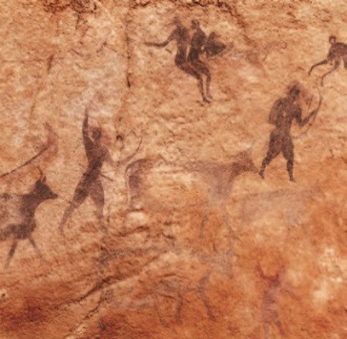
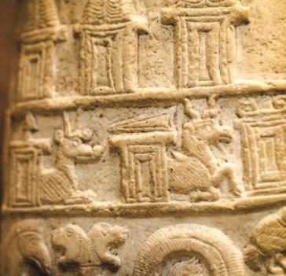
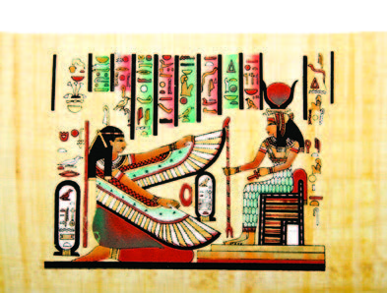

Evolution of Speech and Writing
What were our first attempts at communication?
Our first attempts were with drums, smoke signals, and body language. Later, people invented speech and language.
A cave drawing that communicates a message
Pictographs on stone
Papyrus with hieroglyphics
Chinese characters
How did our writing system evolve?
Pictures on cave walls
Pictures cut into tablets
Papyrus paper and pictograms in Egypt
Ideograms
Chinese characters in China and hieroglyphics in Egypt
Alphabets
The use of the alphabet

Slide 4
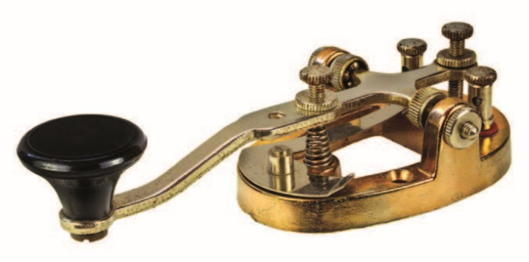
Communicating with Electricity
What discovery enabled many new media technologies?
How to use electricity
What was one of the early inventions after electricity was available?
The telegraph was invented in 1837.
A Morse code telegraph device
What could it do?
It could send signals along wires across the country at the speed of electricity, but it needed skilled operators.
The telegraph worked by connecting two machines with a long wire. A signal using Morse code would be sent from one machine to the other. Operators needed to code and decode the message.
How did it work?

Slide 5
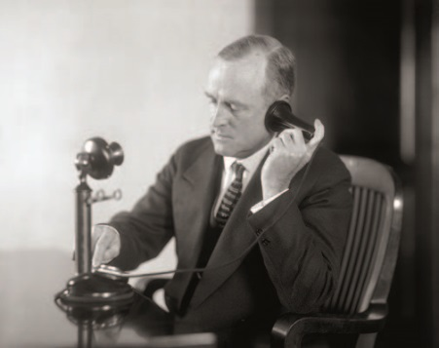
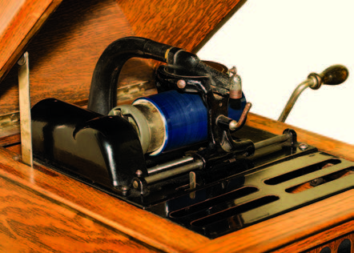
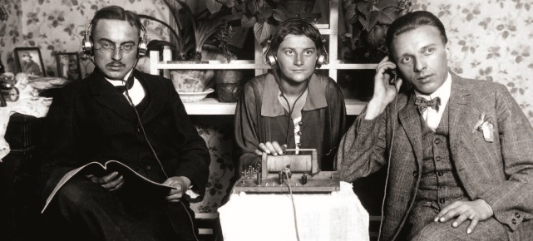
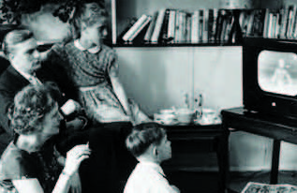
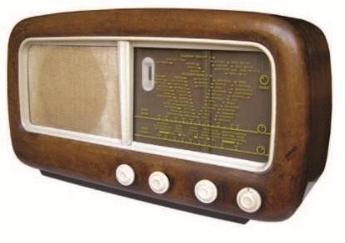
Other Inventions Using Electricity
What were some other inventions?
The telephone (patented in 1876) allowed us to communicate by voice in real time over long distances.
The phonograph (invented in 1877) could record voices and music. For the first time, audio could be recorded for future generations.
The radio (first signal sent in 1895) allowed messages to be heard by anyone at a distance, and without wires.
Television (invented in the 1920s) allowed messages to be heard and seen.
An early telephone
An early sound recording phonograph
Three people listening to the radio
A family watching TV, 1955
An early radio

Slide 6
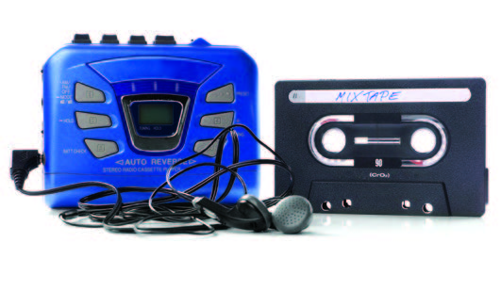
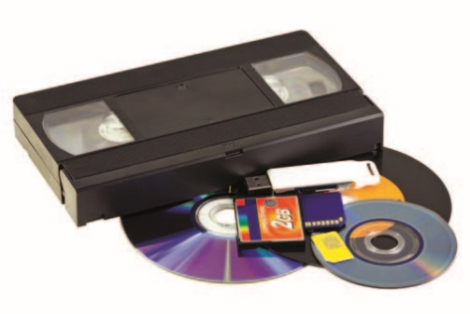

Personal Recorders and Players
How did personal recorders and players evolve?
In the 1960s, people could buy hand-held machines to record music or their own voice. They could make messages and share them with anyone.
A cassette player and a cassette tape
How did listening to music change over time?
People had records, then cassettes, CDs, and MP3 players. Personal music players allowed us to carry our audio with us and listen to anything we wanted at any time.
A video cassette tape, CD, DVD, and other recording technologies
What did video recorders allow people to do?
They allowed us to record shows from television or to make our own movies using video cameras.
A video camera

Slide 7
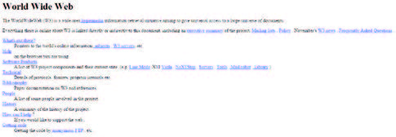
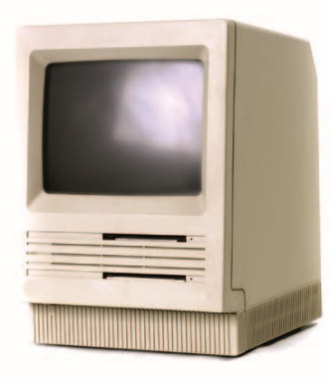
The Internet
Where did the Internet come from?
It was developed out of defense technologies in the US in the 1960s.
How did people communicate before emails?
They sent letters through the postal service.
What soon followed?
When was the first webpage invented?
1990
Internet encyclopedias, dictionaries, video websites, and other web content followed.
The first webpage
An early personal computer
Internet connections

Slide 8
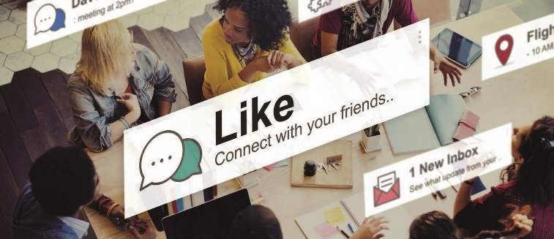

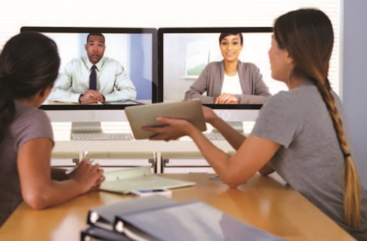
The Internet 2.0
How did the web change in the mid 2000s?
It changed from being passive (read only) into active.
What could people do?
They could leave comments online, create blogs, and upload material to video or social media websites. People created profiles and their own pages to share news, photos, and videos. They also commented on those of others.
Social media
What else developed at that time?
Voice-over-Internet (VOIP) connections also developed.
Making a blog
Voice-over-Internet and tele-conferencing
What could people do with this?
They could make conference calls and communicate with many people all over the world in real time.

Slide 9
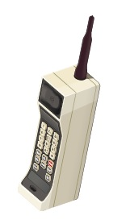
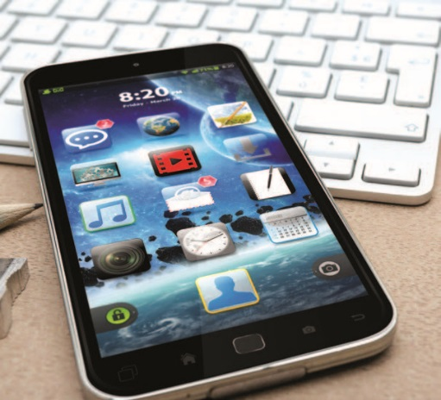
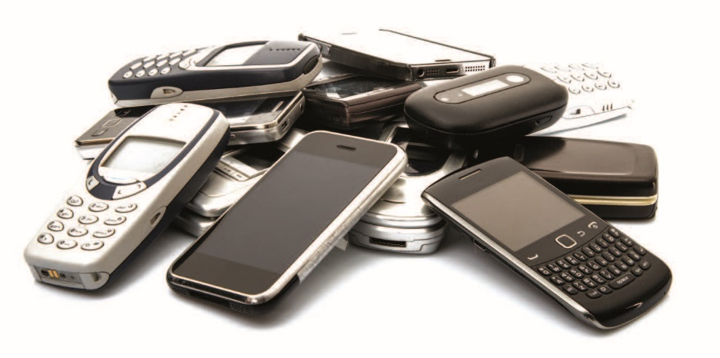
Mobile Phones
1980s mobile phone
A smartphone
Older mobile phones
In the 1980s, they were big and difficult to use. By the late 1990s, the phones were small and light enough to fit in your pocket. They also offered email and some basic Internet features. In the late 2000s, smartphones appeared with full Internet access and applications such as games, maps, and music.
How have mobile phones evolved?

Slide 10
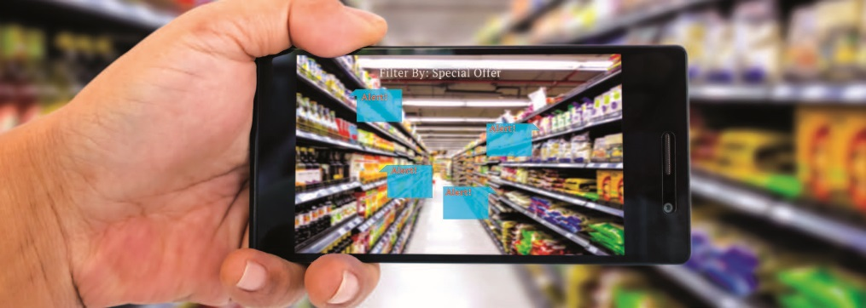
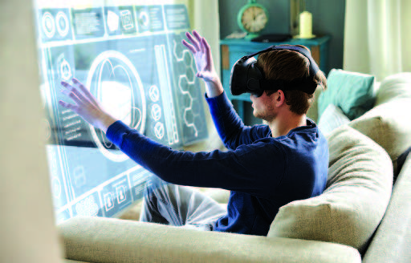
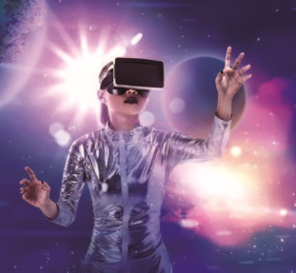
Augmented and Virtual Reality
What is augmented reality?
Augmented reality
This is where applications can display images on a live video background of the real world in real time. For example, our phones can display additional information about the food we see in the store as we shop.
What is virtual reality and how is it different from augmented reality?
Virtual reality
The two are similar, but rather than telling us about a real physical environment, virtual reality creates its own world. It has its own sights and sounds.
In a virtual reality world

Slide 11

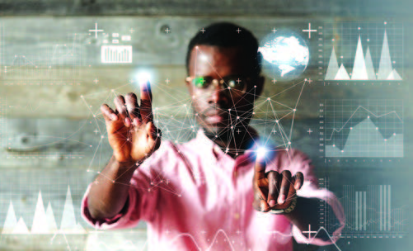
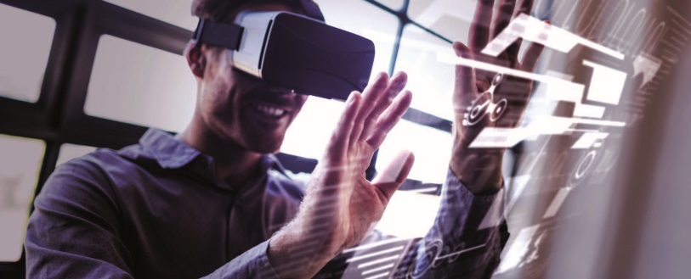
Perceptual Computing
In perceptual computing, computers are programmed to recognize what is going on around them. For example, the perceptual computer can determine what needs a user may have as well as react to or receive additional information.
What is perceptual computing?
Perceptual computers recognize the people they interact with.
New computer interfaces
Using gestures to control computers
How does perceptual computing work?
The computer uses depth sensors, cameras that give 3D vision, and an immersive experience in order to understand the world around it.

Slide 12

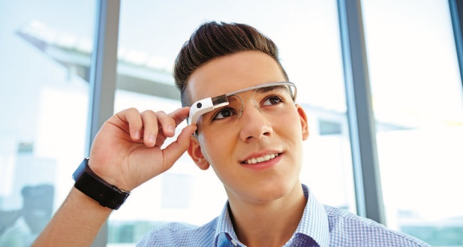
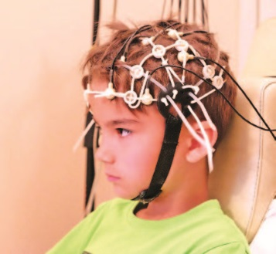
Wearable Devices
What is another emerging technology?
What can they do?
Wearable devices
They can either enhance our natural abilities or restore something that was lost.
What are some examples of wearable devices?
• Ear devices that can help us hear a conversation happening 10 meters away while filtering out some voices and focusing on others.
• Wearable computer glasses that can record our conversations, or restore sight to some blind people.
A hearing aid
Wearable computer glasses
What might we be able to do in the future?
Someday, we might be able to communicate from brain to brain!
Reading brain waves

Slide 13
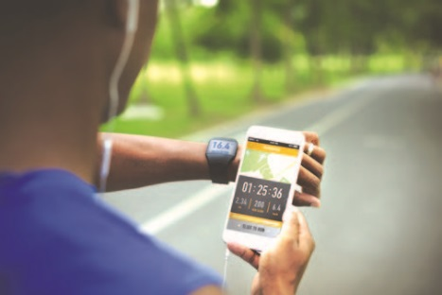
Helpful or Dangerous?
What will continue to happen as time moves on?
Many more of our devices will become “smart devices,” and they will communicate with each other using the Internet.
What is an example of how this technology might change our lives in the future?
In the future, our phones will probably be able to tell us when to visit the doctor based on body scanning software.
Monitoring our health with devices
What are some of the problems that come along with smart devices?
How might people negatively change in the future?
Some people might come to prefer their virtual worlds to their real lives. People might become too isolated, waste too much time, or care about the wrong things. Cyber crime might skyrocket, too.
Huge amounts of data will be collected about our personal lives, and that data could be used to hurt us.

Slide 14


Vocabulary
cave n.
a large hole in the side of a hill or under the ground
encyclopedia n.
a book or set of books giving information about all areas of knowledge, usually arranged in alphabetical order

Slide 15


Vocabulary
fridge n.
a piece of electrical equipment in which food is kept cold so that it stays fresh
ideograph n.
a written sign or symbol that represents an idea or object

Slide 16

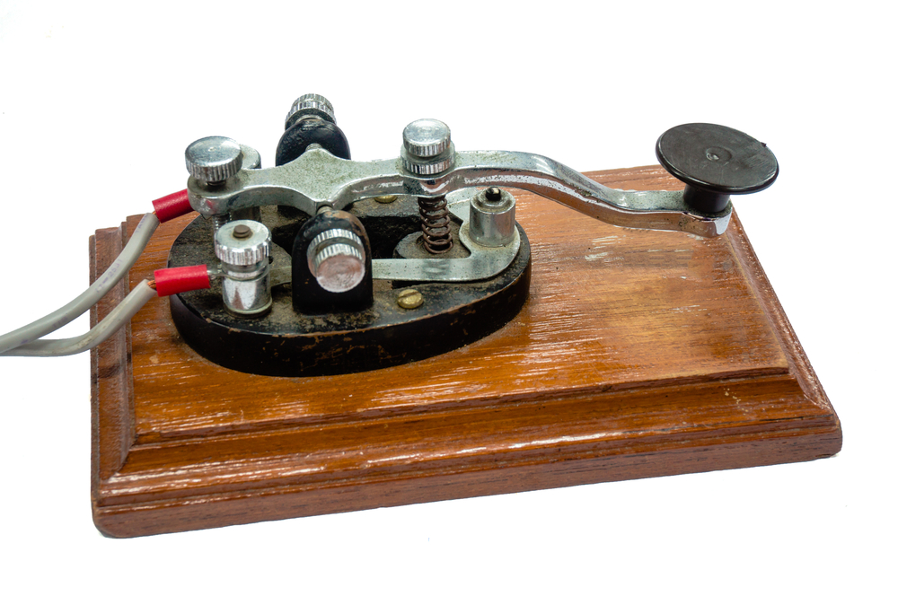
Vocabulary
pictogram n.
a picture made to represent an object or action
telegraph n.
a method of sending messages over long distances using wires that carry electrical signals, or the special equipment used for this purpose

Slide 17
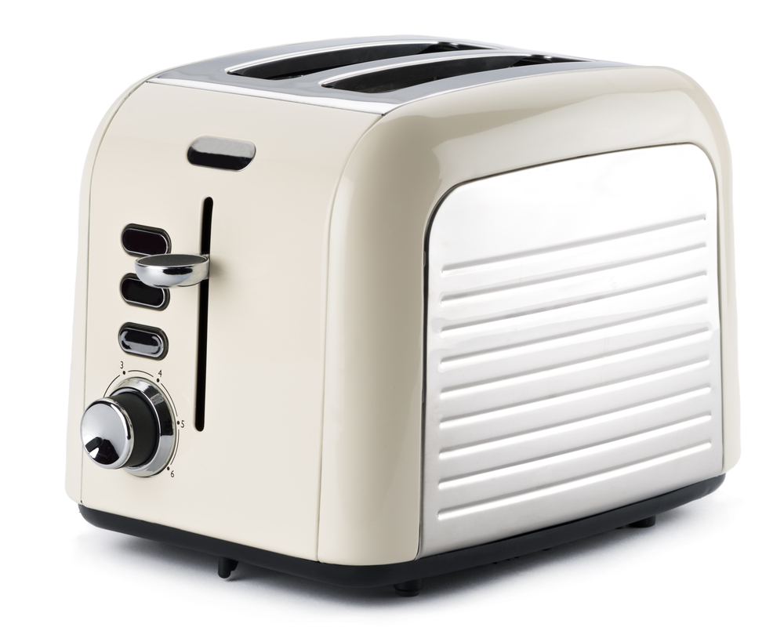

Vocabulary
toaster n.
an electrical machine that you put slices of bread in to make toast
webpage n.
a page of information on the Internet about a particular subject, that forms (a part of) a website

